Slide 1



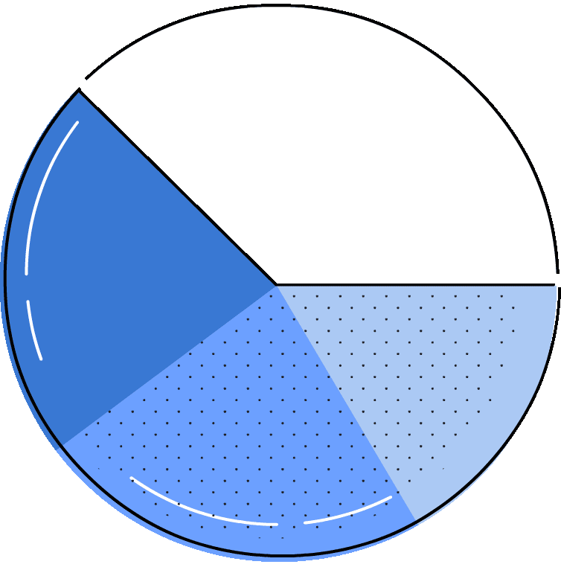


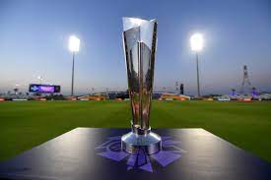


T-20 World Cup 2022 Data Analysis
Sixes, Wickets, and Insights: A Data-Powered Look at the T-20 World Cup
By - Sanskriti Malviya

Slide 2
Aim - Our mission is to unravel the stories hidden within this dataset by:
1. Data Exploration: Delve into the dataset to uncover trends, patterns, and insights. Analyze theperformance of teams, players, and key events within the matches.
2. In-Depth Analysis: Examine player statistics, including runs, wickets, and over-by-over progress, to understand the dynamics of the game.
3.Event Inference: Identify and analyze critical match events, such as boundaries, wickets, and
strategic moments. Uncover the factors that contribute to the success or downfall of a team.
4.Performance Evaluation: Evaluate individual and team performances, including standout
players, consistent run-scorers, and top wicket-takers. Discover what sets them apart.
5.Statistical Insights: Utilize statistical techniques to gain insights into team strategies, batting, bowling, and match outcomes. Create visualizations that convey the story of the tournament.

Slide 3




Data Exploration:
We'll use Python libraries like Pandas and Plotly to analyze the data.
The data includes match details, player statistics, match events, and even commentary snippets.
This allows us to understand the game's flow, analyze turning points, and get a feel for the atmosphere.

Slide 4
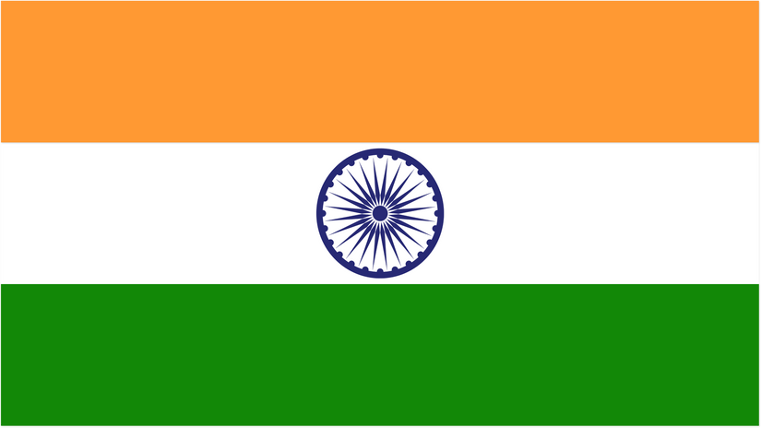




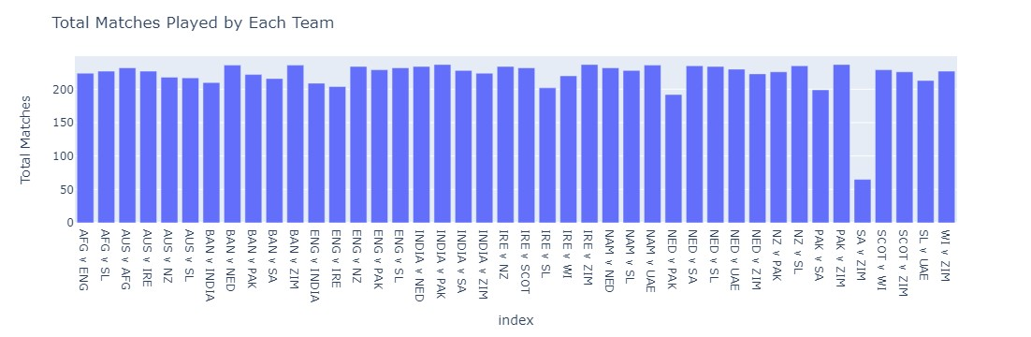
Team Perfoemance Analysis :
Visualizations will be key to understanding team performances.
This chart shows the total number of matches played by each team.

Slide 5
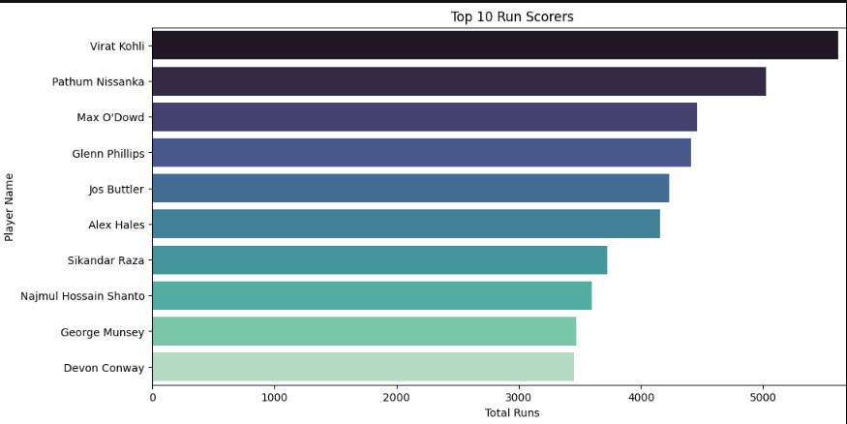
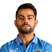


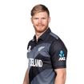
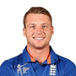

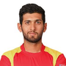
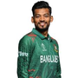

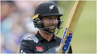
Player Performance Analysis - Runs
We'll identify the top run scorers and analyze their performances.
This chart showcases the players with the most runs scored.

Slide 6
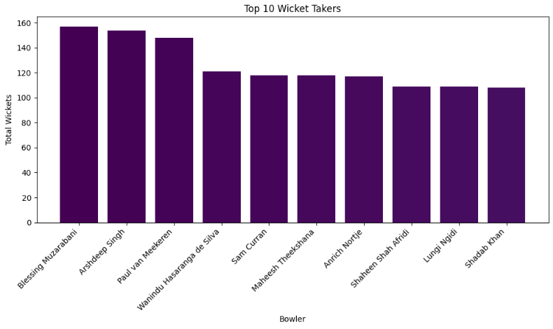
Player’s Performance - By Wickets

Slide 7
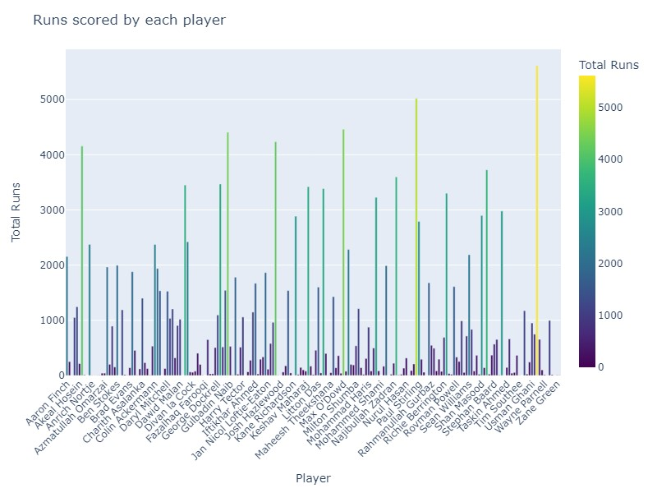

Slide 8
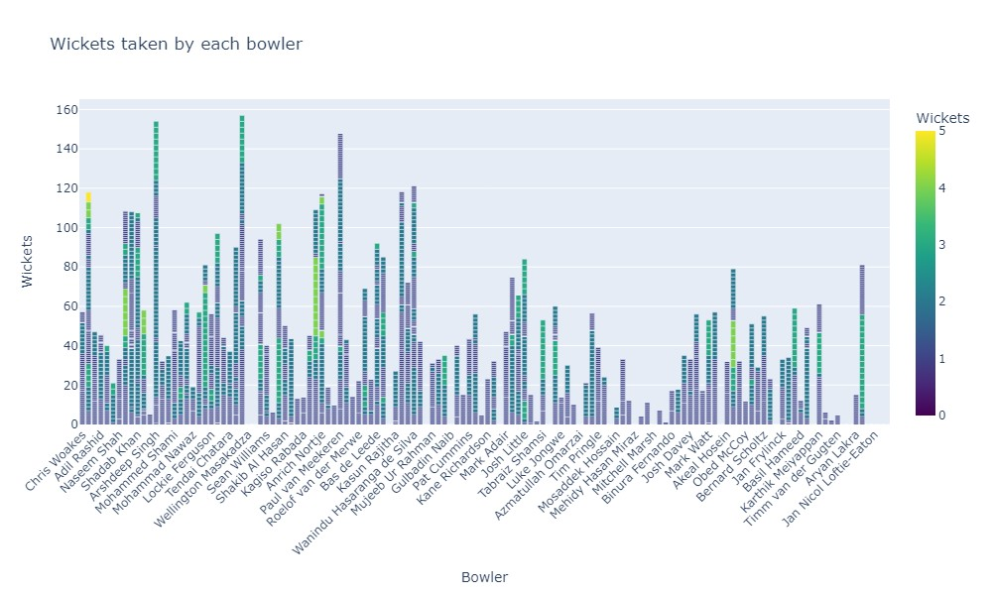

Slide 9
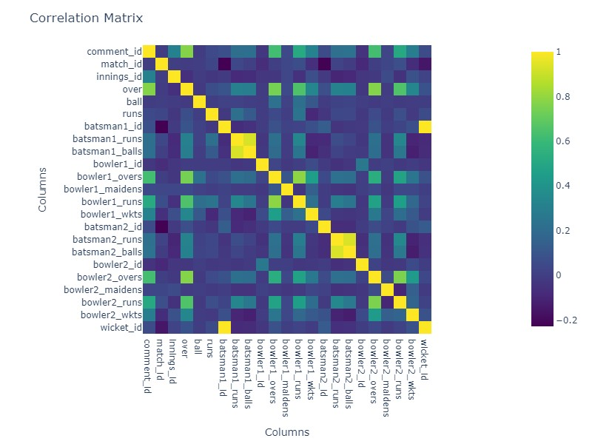

Slide 10
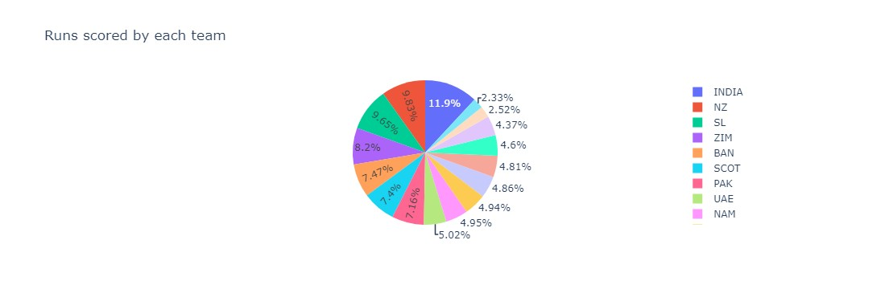

Slide 11
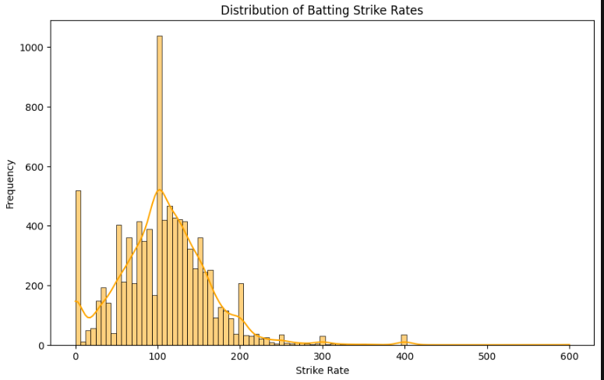

Slide 12
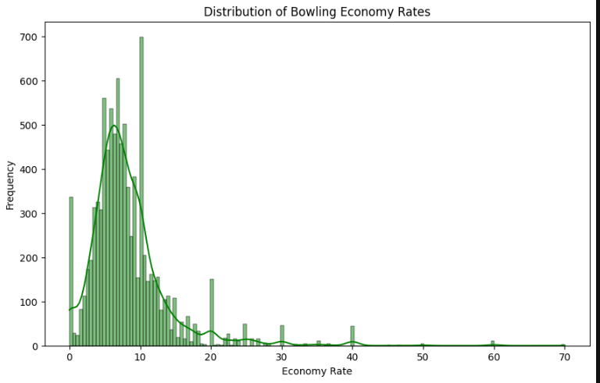

Slide 13

Some of the standout players who had some impressive performances .
Award Winners:
Player of the Tournament: Sam Curran (England) - Exceptional bowling throughout, taking 13 wickets in just 6 games.
Most Runs: Virat Kohli (India) - Scored 296 runs, showcasing his experience and consistency.
Most Wickets: Wanindu Hasaranga (Sri Lanka) - The highest wicket-taker with 15 scalps in 8 matches, showcasing his spin mastery.
Other Standout Players:
England: Jos Buttler, Alex Hales, Ben Stokes (batters), Adil Rashid (bowler) - England's overall dominance featured strong contributions from these players.
Pakistan: Mohammad Rizwan (batter) - Provided stability at the top of the order.
Netherlands: Bas de Leede (bowler) - One of the surprise performers, taking 13 wickets.

Slide 14
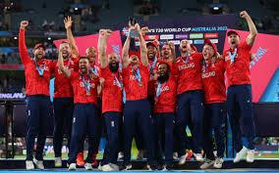
Lifting the trophy! England on top!

Slide 15
Thank You!

